Slide 1
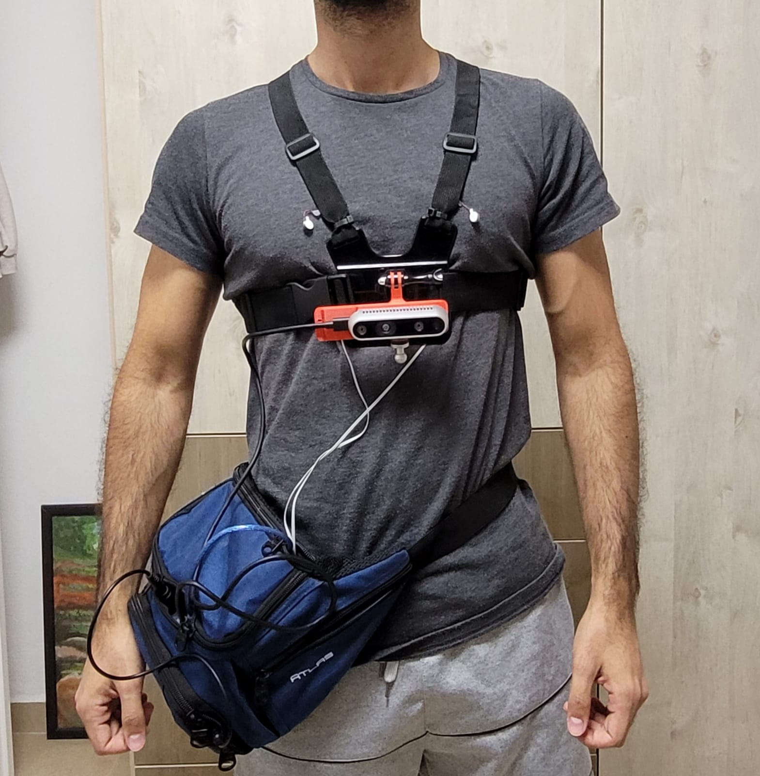
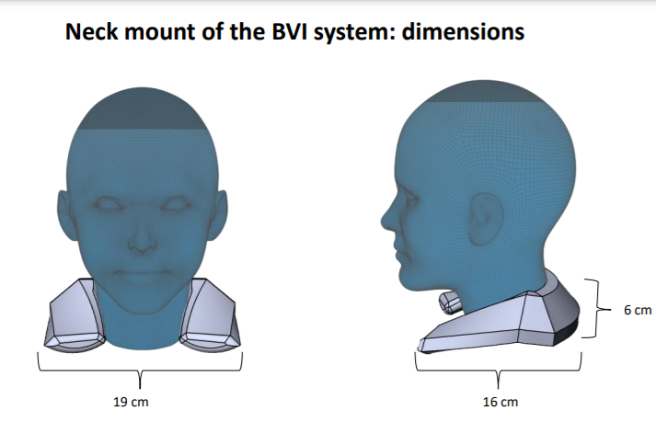
Hardware and software of the system
Sensing unit
Feedback unit
processing unit

Slide 2
Tasks for part 1 of the project
Reduce algorithm run time in Python to 120 ms for each frame
Generate SLAM in off-line and on-line modes
Generate control in off-line and on-line modes

Slide 3
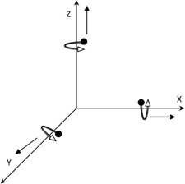
Bypassing obstacles on S.W. – algorithm modules
Motion direction
Euler angles pitch and roll (IMU)
R.S. P.C.
P.C. Plane fit
Scan matching
R.S. ax,ay,az
Translation filter
SLAM
Control
User feedback
R.S. texture
Euler angle yaw (IMU)

Slide 4
Bypassing obstacles on S.W. – algorithm modules
Run-time | Performance test | Output module | Output | Input | Input module | Module name
Matlab: Python: | Walk for 50m and set stride parameters K1&k2 such that the cumulative strides length is 50m | Scan matching | IMU X-Y translations at 6Hz | IMU acceleration raw data at 200Hz | RealSense, IMU, accelerometer, | Translation filter
 | Compare STD of P.C. in z-axis inside a bounding box around the center of the plane to a bounding frame surrounding this box (function plane_fit_metric) | Scan matching | Rotated P.C. frame to fit S.W relative to X-Y plane | P.C. ; euler angles (madgwick filter) | RealSense, P.C. Euler angles pitch and roll (IMU) | P.C. Plane fit
 | Compare translation based on IMU with translation based on scan matching, compare yaw angle to derived yaw angle | SLAM | Frame (i to i+1) translation and yaw; d-frame top view(above/below ground) | Rotated P.C. frames (i-1 and i); frame (i-1 to i); IMU dx,dy translation; Yaw and texture; | 1. P.C. Plane fit 2. RealSense texture 3. IMU yaw 4. Translation filter | Scan matching
 | Measure the width along the 50m route on the S.W. and compare it to that derived from the SLAM | Control | SLAM | Translations and yaw(tx and yaw), D-frames – ground levels (plus/minus) SLAM frames – xplus/minus | Scan matching | SLAM
 |  | User feedback | Vibration control | SLAM | SLAM | Control
 |  | NA | Activating # motor 1/ 2/ 3 | Activating motor # 1/ 2/ 3 | Control | User feedback

